Slide 1
Team 6 Swivel
Schietecat M.
Smets K.

Slide 2
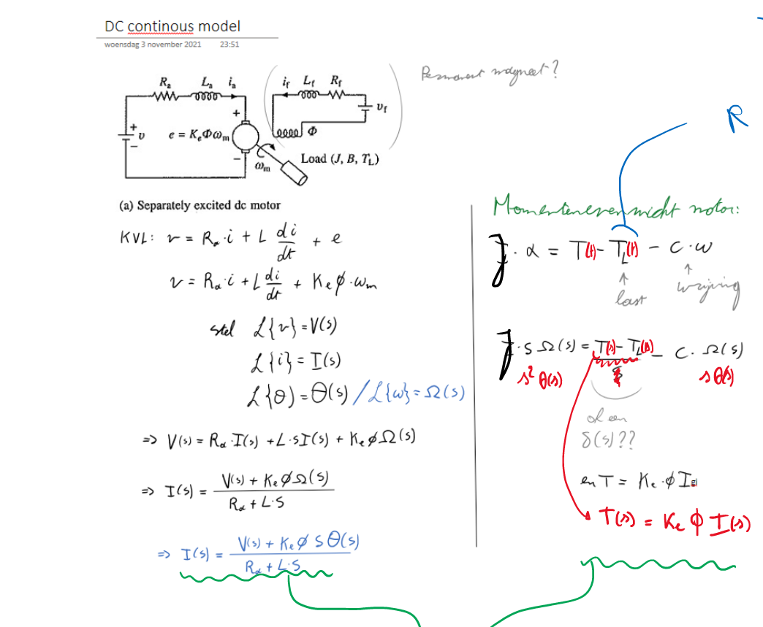
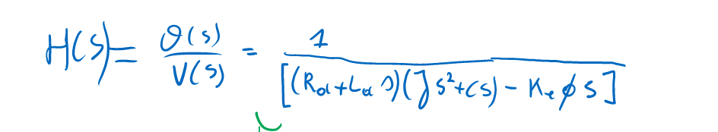

Model
Resulting TF
Discrete form:
5 zero’s
6 poles (incl 1 delay)
P&O: elektrotechniek (B-KUL-H01Q6C)
EAGLE 2
!!!Fill in your module!!!

Slide 3
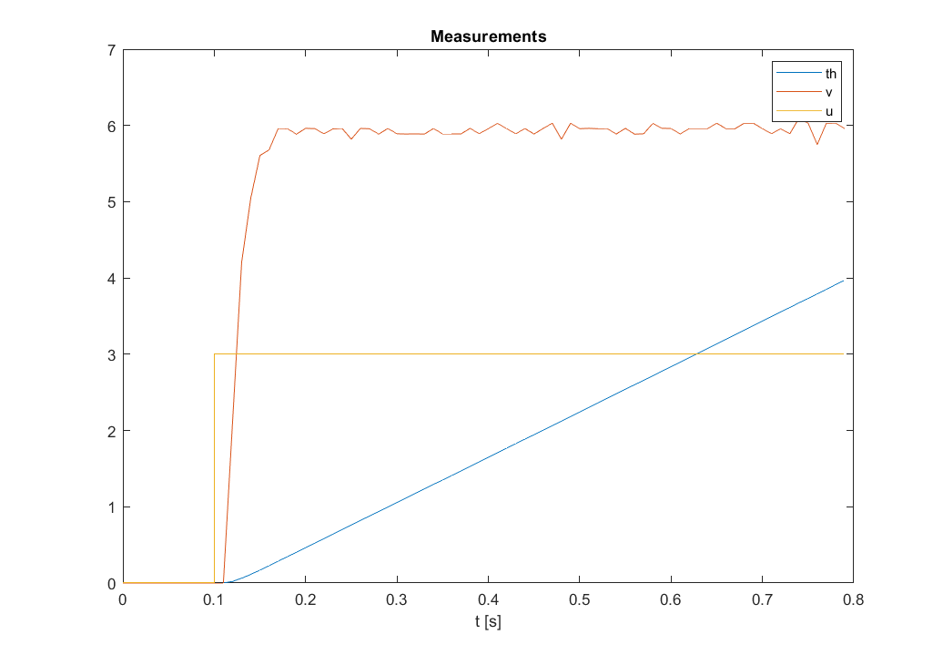
Excitation
P&O: elektrotechniek (B-KUL-H01Q6C)
EAGLE 2
!!!Fill in your module!!!

Slide 4
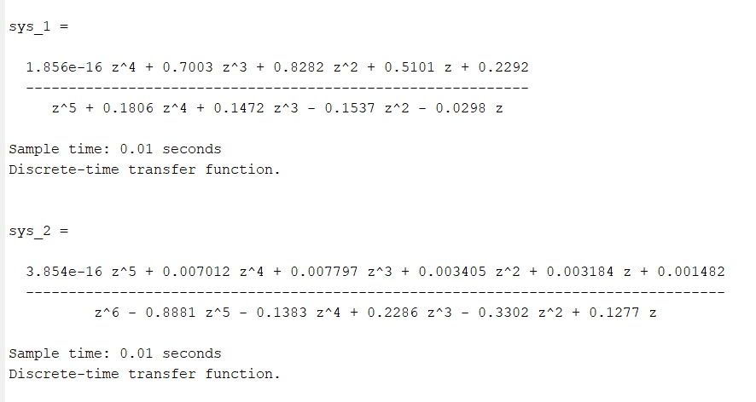
Results
P&O: elektrotechniek (B-KUL-H01Q6C)
EAGLE 2
!!!Fill in your module!!!

Slide 5
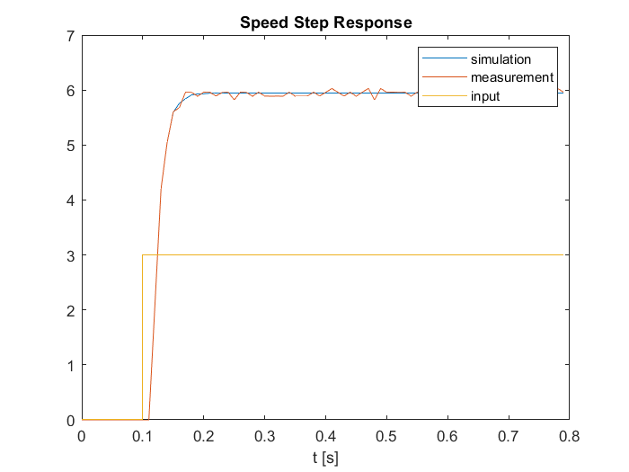
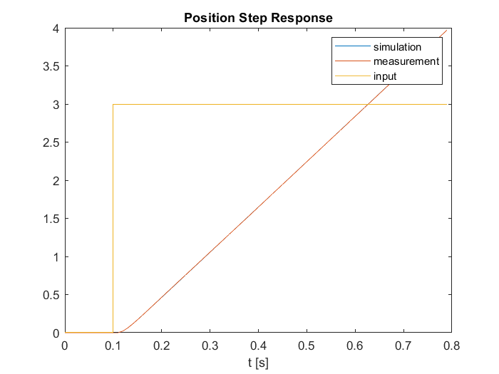
Results: validation
P&O: elektrotechniek (B-KUL-H01Q6C)
EAGLE 2
!!!Fill in your module!!!

Slide 6
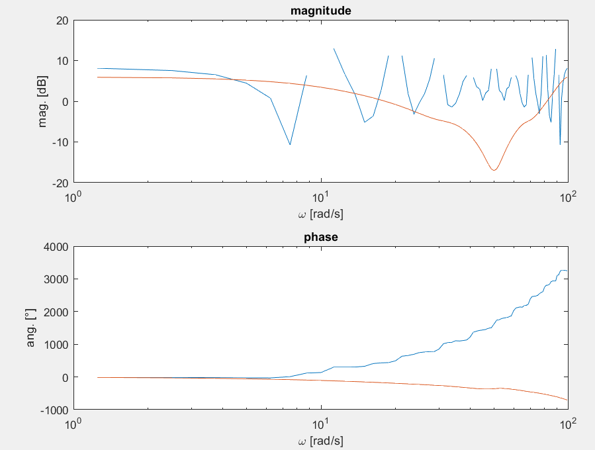
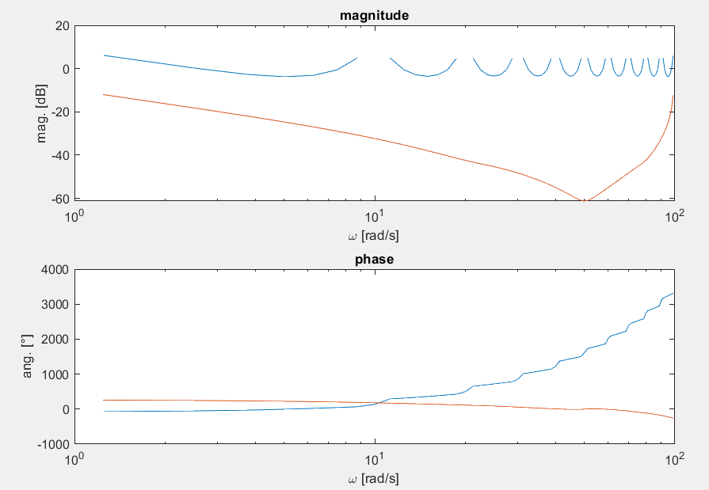
Results: validation
Speed model
Posit model
P&O: elektrotechniek (B-KUL-H01Q6C)
EAGLE 2
!!!Fill in your module!!!

Slide 7
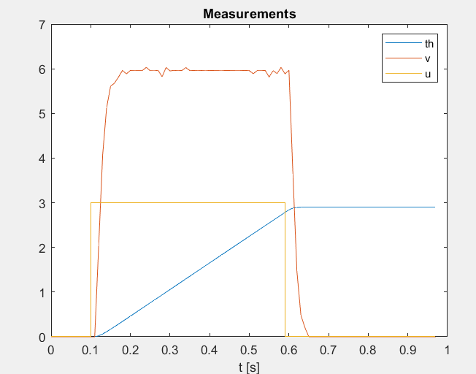
Excitation
P&O: elektrotechniek (B-KUL-H01Q6C)
EAGLE 2
!!!Fill in your module!!!

Slide 8
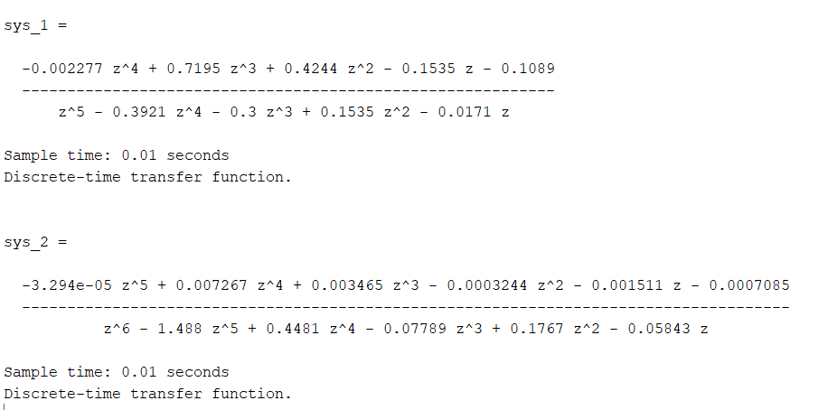
Result
P&O: elektrotechniek (B-KUL-H01Q6C)
EAGLE 2
!!!Fill in your module!!!

Slide 9
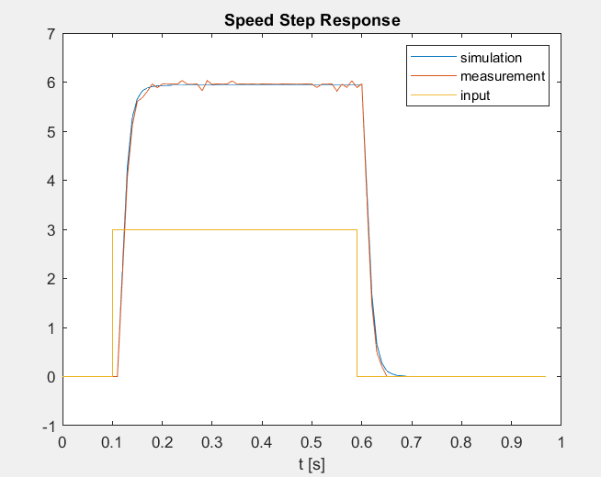
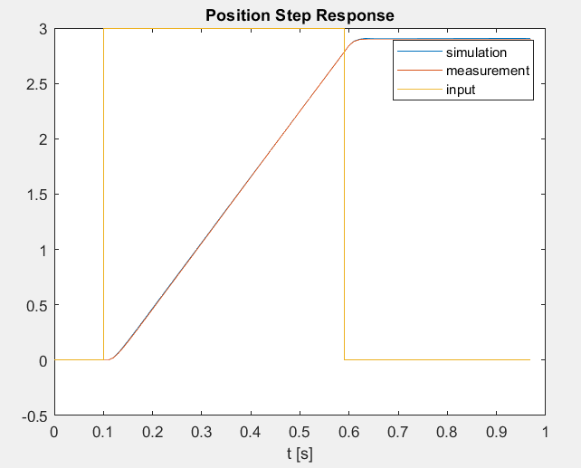
Result: validation
P&O: elektrotechniek (B-KUL-H01Q6C)
EAGLE 2
!!!Fill in your module!!!

Slide 10
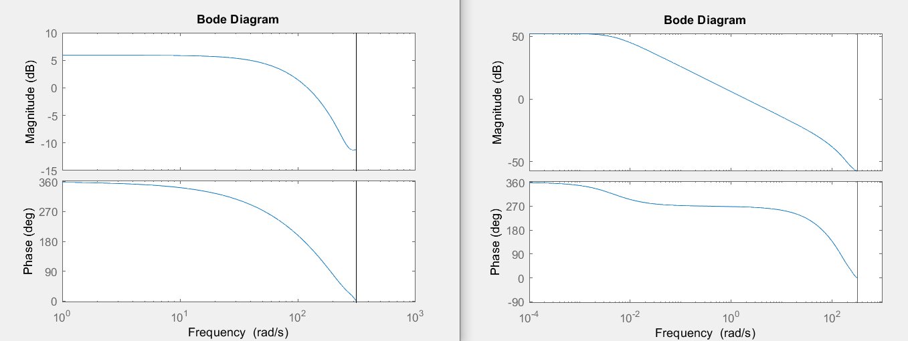
Result: validation
Speed model
Posit model
P&O: elektrotechniek (B-KUL-H01Q6C)
EAGLE 2
!!!Fill in your module!!!

